Slide 1
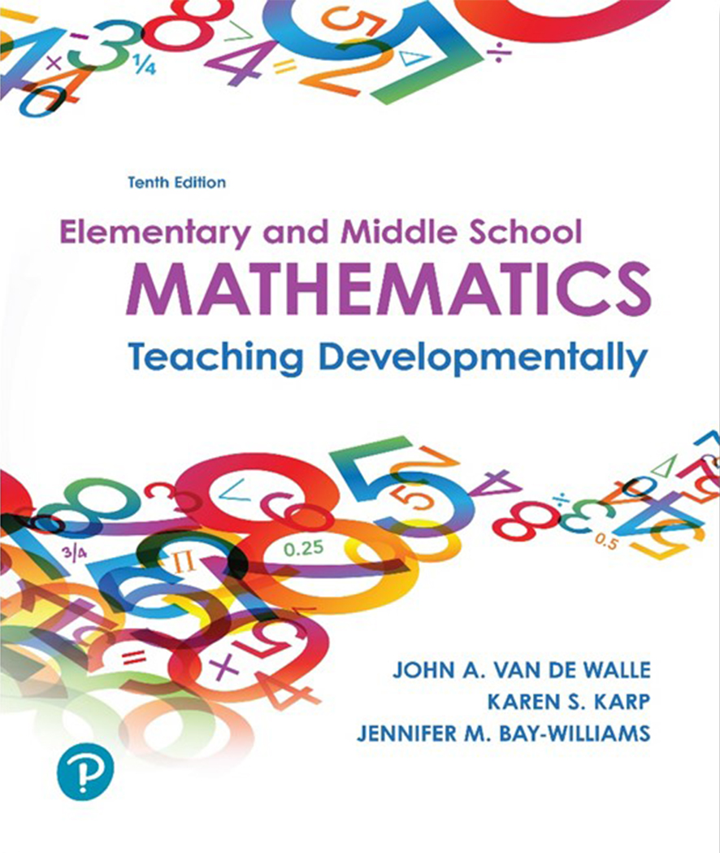
Elementary and Middle School Mathematics Teaching Developmentally 10th Edition
Chapter 10
Developing Whole-Number Place-Value Concepts
Copyright © 2019, 2016, 2013 Pearson Education, Inc. All Rights Reserved
Notes:
If this PowerPoint presentation contains mathematical equations, you may need to check that your computer has the following installed:
1) MathType Plugin
2) Math Player (free versions available)
3) NVDA Reader (free versions available)

Slide 2
Learner Outcomes (1 of 2)
10.1 Identify the pre-base-ten understandings based on a count-by-ones approach to quantity.
10.2 Recognize the foundational ideas of place value as an integration of three components: base-ten concepts through groupings and counting, numbers written in place-value notation, and numbers that are spoken aloud.
10.3 Demonstrate how to develop students’ skills in place value through the use of base-ten models.
10.4 Explain how students can use grouping activities to deepen their understanding of place-value concepts.

Slide 3
Learner Outcomes (2 of 2)
10.5 Explain strategies to support students’ ability to write and read numbers.
10.6 Recognize that there are patterns in our number system that provide the foundation for computational strategies.
10.7 Describe how the place-value system extends to large numbers.

Slide 4
Pre-Place-Value Understandings
Children’s pre-place-value view of number
Ask first or second-graders to count out 53 tiles. Watch closely to note whether they count out the tiles one at a time or push put them into a pile without any type of grouping or if they group them into tens. Have the students write the number that tells how many tiles they just counted.
You will likely find that early on, students count the tiles one by one and are not thinking of ten as a unit and are therefore in a pre-place-value stage.

Slide 5
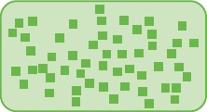
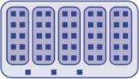
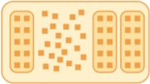
Three Stages of the Grouping of 53 Objects
Grouping Stage | Visual Representation | Counting Approach | Students Can:
Unitary Count by ones | 1 group of many dots, scattered without pattern. | 1, 2, 3, 4, 5, 6, 7, 8, 9, 10, 11, and so on | Name a quantity or “tell how many” by counting each piece. Are not yet able to think of 10 as a single unit. Use counting by ones as the only way they are convinced that different sets have the same amount.
Base Ten Count by groups of tens and ones | 5 groups of 10 dots each, and 3 single dots. | 1, 2, 3, 4, 5 groups of 10 and 1, 2, 3, ones (singles) or 10, 20, 30, 40, 50, 51, 52, 53 | Count a group of 10 objects as a single item (unitizing). Coordinate the base-ten approach with a count by ones to as a means of telling “how many.”
Equivalent Nonstandard base ten | There are 3 groups of 10 dots, and a group of many dots, scattered. | Before counting students would trade and then count 10, 20, 30, 40, 50, 51, 52, 53 | Group the pieces flexibly into versions that include tens and ones but all trades have not been carried out. Use these alternate groupings to relate to computation by being able to trading or regroup numbers in a variety of ways.

Slide 6
Integrating Base-Ten Groupings with Words
Groupings of ten matched with numerals
Numerals put in place value - Use base-ten language
Written in standard form

Slide 7
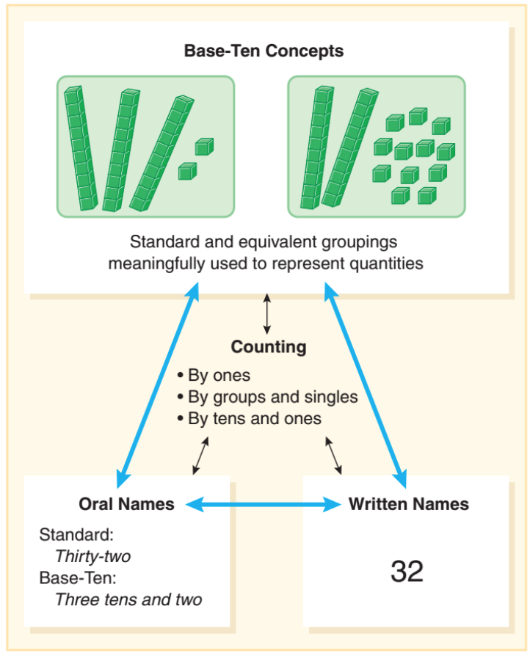
Integrating Base-Value Grouping with Place Value Notation

Slide 8
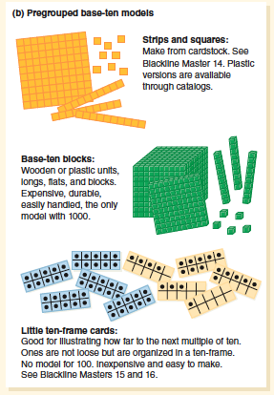
Base-Ten Models for Place Value
Groupable base-ten models
Pregrouped base-ten models

Slide 9
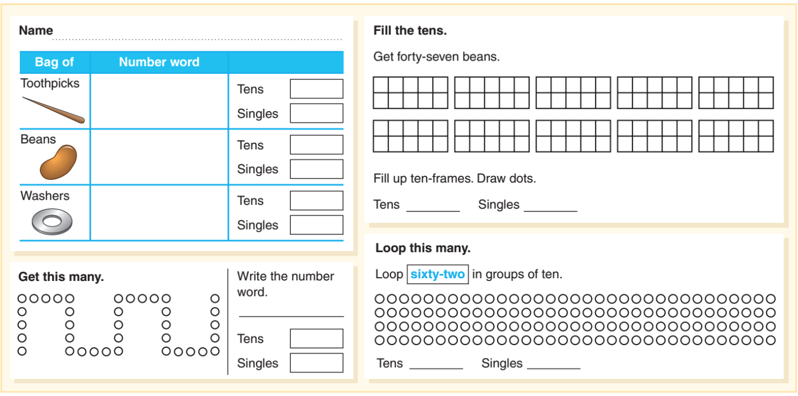
Activities to Develop Base-Ten Concepts

Slide 10
Activity 10.4 Too Many to Count?
Grouping Tens to Make 100
Materials-Any quantity with 150 to 1000 items e.g. large a bag of toothpicks, buttons, beans, plastic chips, straws, craft sticks
Directions:
Make and record estimates of how many items are in the jar, bag, box etc.
Discuss how they determined their estimates.
Distribute portions of the items to groups to count (provide cups, plastic bags or rubber bands).
Collect leftovers and put them in groups of ten.
Now ask, “How can we use these groups of ten to tell how many items we have?” “Can we make new groups of ten?” What is 10 groups of ten called?”

Slide 11
Activity 10.7 Base-Ten Riddles
Equivalent Representation
Materials – Base-Ten Riddle Cards - Present the riddles orally or written.
I have 23 ones and 4 tens. Who am I ?
I have 4 hundreds, 12 tens and 6 ones. Who am I?
I have 30 ones and 3 hundreds. Who am I?
I am 45. I have 25 ones. How many tens do I have?
I am 341. I have 22 tens. How many hundreds do I have?
If you put 3 more tens with me, I would be 115. Who am I?
I have 17 ones. I am between 40 and 50. How many tens do I have?
Have students write new riddles.

Slide 12
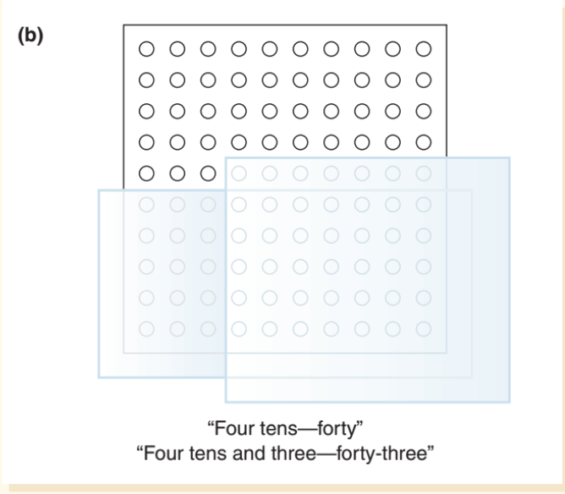
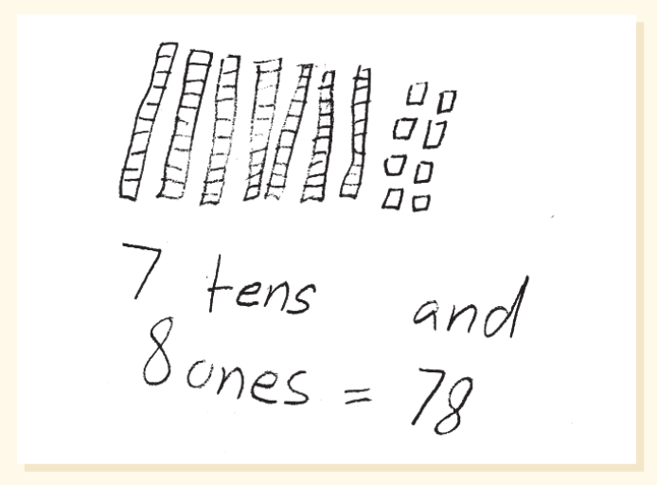
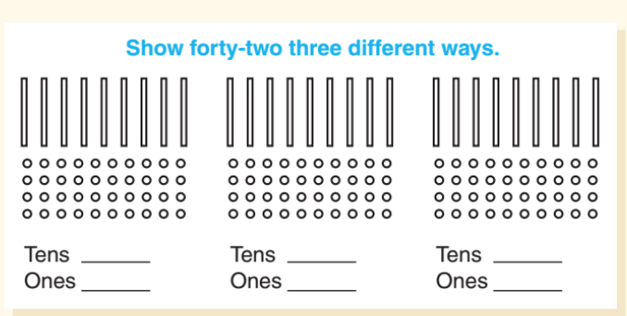
Reading and Writing Numbers (1 of 2)

Slide 13
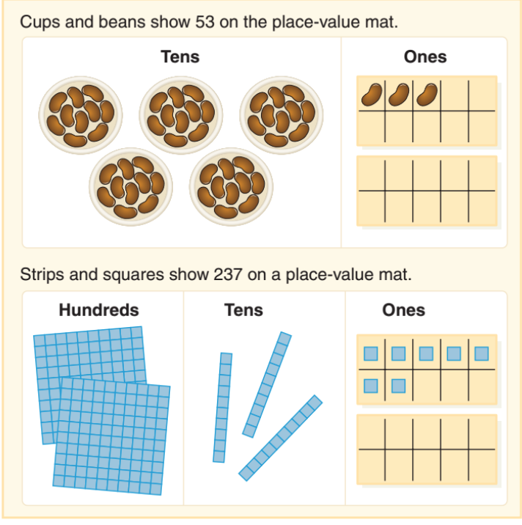
Reading and Writing Numbers (2 of 2)
The use of place value mats provides and method for children to organize their materials.
Two ten frames in the ones place help eliminate the repeated counting of ones.

Slide 14
Five Levels of Place Value Understanding
Single numeral. The student writes 36 but views it as a single numeral. The individual digits 3 and 6 have no meaning by themselves.
Position names. The student correctly identifies the tens and ones positions but still makes no connections between the individual digits and the blocks.
Face value. The student matches 6 blocks with the 6 and 3 blocks with the 3.
Transition to place value. The 6 is matched with 6 blocks and the 3 with the remaining 30 blocks but not as 3 groups of 10.
Full understanding. The 3 is correlated with 3 groups of ten blocks and the 6 with 6 single blocks.

Slide 15
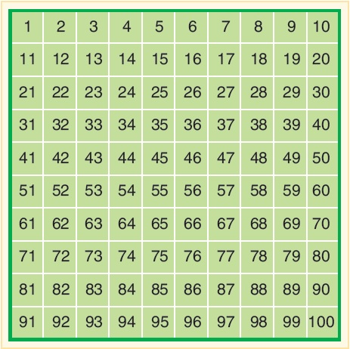
Place Value Patterns and Relationships A Foundation for Computation
The hundreds chart is an important tool in development of place value.
Recognizing place-value related patterns
Relationships with landmark numbers
Number relationships for addition and subtraction

Slide 16
Relative Magnitude Using Benchmark Numbers
Activity 10.17 Who Am I?
Materials - A long line on a strip of paper and labeled 0 and 100
Directions: Mark a point with a ? that corresponds with your secret number.
Have students try to guess and label and mark that number on the line until your secret number is discovered.
Variations-
End points can be different 0 to 1000, 200 to 300, 500 to 800

Slide 17
Connections to Real-World Ideas
Encourage students to notice numbers in the world around them.
Where are numbers used in this school?
Number of third graders
Number of minutes devoted to mathematics each week
Number of days since school started
Number of cartons of chocolate or plain milk sold in the cafeteria
What do you do with these numbers?

Slide 18
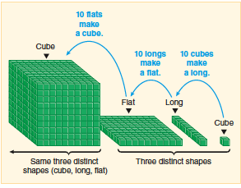
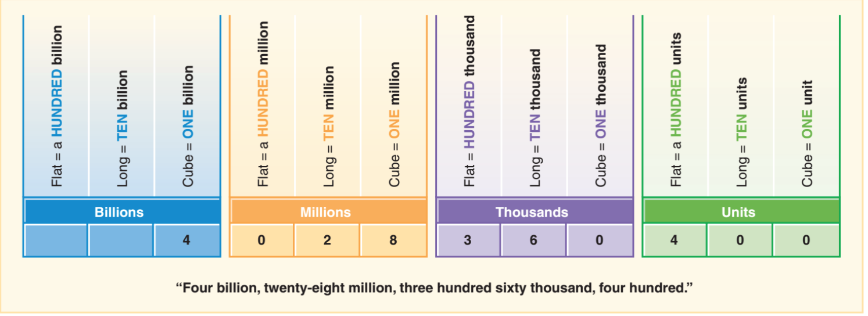
Numbers Beyond 1000
Multiplicative structure of number- ten in any position makes a single thing (group) in the next position to the left
Conceptualizing large numbers
Reading numbers in triples and then naming the unit (don’t use the word and, which is reserved for the decimal point)

Slide 19
Common Errors and Misconceptions in Place Value (1 of 2)
Misconception/ Error | What It Looks Like | How to Help
Students lose track of the fact that each digit in a multidigit numeral carries a value dependent on its position in the number. | When students are asked to compare the numbers (2) bolded in the two amounts that follow they will say they are the same. 2357 and 49,992. | Use Base-Ten Materials and have student show with materials the value of these two numbers. The reading of numbers in addition or subtraction problems as digits (saying 5 instead of 5 tens or fifty) confuses students. Use the place value cards discussed previously to reinforce how numbers are built. Students hear numbers like 2,357 read as two, three, five, seven—when they should always be read two thousand, three hundred, fifty-seven. Use the digit correspondence task described in this chapter to identify which of the five levels of understanding matches your student’s performance. Reinforce that the value of an individual digit in a multidigit number is the product of that digit multiplied by the value assigned to its position in the number

Slide 20
Common Errors and Misconceptions in Place Value (2 of 2)
Students reverse the digits when writing two-digit numbers.
Students represent a number with base-ten materials using the face value of digits.
Students put the word “and” in a number word when they read it aloud.
Students use a form of “expanded number writing”.
When shown a collection base-ten materials where there is an internal zero the students ignore the zero or misunderstand the zero.
If students are given the place values of numbers out of order, they write the number as given left to right regardless of the place value.
Students misinterpret the value of base-ten materials.

