Slide 1
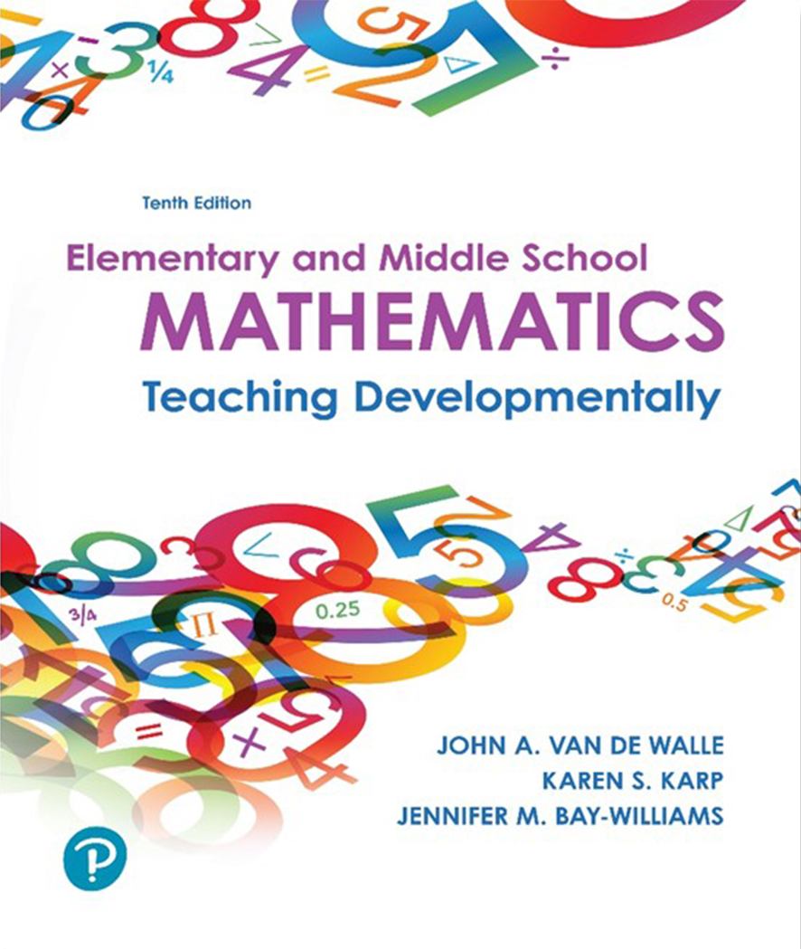
Elementary and Middle School Mathematics Teaching Developmentally 10th Edition
Chapter 1
Teaching Mathematics in the 21st Century
Slides in this presentation contain hyperlinks. JAWS users should be able to get a list of links by using INSERT+F7
Copyright © 2019, 2016, 2013 Pearson Education, Inc. All Rights Reserved
Notes:
If this PowerPoint presentation contains mathematical equations, you may need to check that your computer has the following installed:
1) MathType Plugin
2) Math Player (free versions available)
3) NVDA Reader (free versions available)

Slide 2
Learner Outcomes
1.1 Summarize the factors that influence the effective teaching of mathematics.
1.2 Describe the importance of content standards, process standards and standards of mathematical practice.
1.3 Explore the qualities needed to learn and grow as a professional teacher of mathematics.

Slide 3
Changing World: Factors to Consider
International and national assessments provide strong evidence that mathematics teaching must change:
for our students are to be competitive in the global market
for our students to be able to understand the complex issues they must confront as responsible citizens.

Slide 4
Movement Toward Shared Standards
1980s response to “back to basics”
1989 N C T M published Curriculum and Evaluation Standards for School Mathematics
1995 N C T M published Assessment Standards for School Mathematics
2000 N C T M published Principles and Standards for School Mathematics
2006 N C T M published Curriculum Focal Points
2010 C C S S O presented Common Core State Standards
2014 N C T M published Principles to Action

Slide 5
Common Core State Standards and Domains by Grade Level
Table 1.1 Standards for Mathematical Practice

Slide 6
Five Process Standards from Principle and Standards for School Mathematics
Problem Solving
Reasoning and Proof
Communication
Connections
Representation
How would these be evident in the teaching and learning in your classroom?

Slide 7
Standards for Mathematical Practice from C C S S-M
Processes and proficiencies that must be developed in every student.
Regardless of standards in your state, it is your job to support parents and families of your students to understand the research behind the standards.
Who makes the curricula decisions in your classroom?
_____ _____ _____

Slide 8
Six Guiding Principles from Principles to Action
Teaching and Learning
Access and Equity
Curriculum
Tools and Technology
Assessment
Professionalism
Explore the guiding principles on webcasts presented on N C T M website (www.nctm.org).

Slide 9
Principles to Action
Pause and reflect on these statements:
Use meaningful instructional tasks.
Provide instructional opportunities for students to demonstrate their competence in different ways.
Avoid thinking of a curriculum as a checklist or disconnected set of daily lessons.
Consider the use of multiple assessments to capture a variety of student learning styles.

Slide 10
An Invitation to Learn and Grow
Knowledge of Mathematics - Profound, flexible and adaptive knowledge
Persistence - Stave off frustration and demonstrate persistence
Positive attitude - Changing attitudes toward mathematics is easy
Readiness for change - Unlearn and relearn mathematical concepts
Willingness to be a Team Player - All teachers using same language, symbols, models and notation, year after year.

