Slide 1
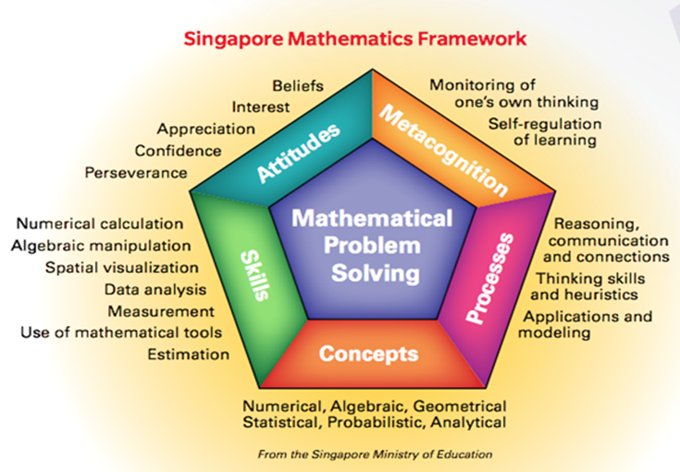
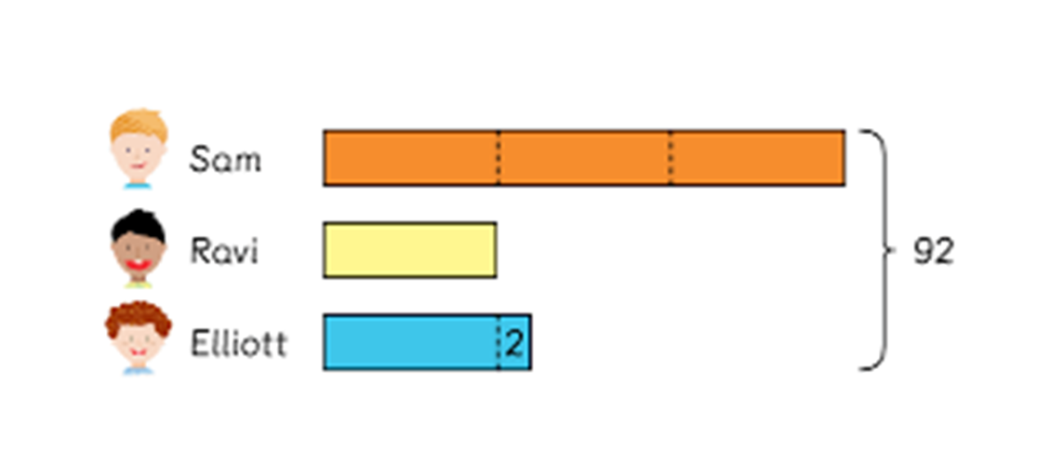
Exploring the Influence of the Singapore Modeling Method on Prospective Elementary Teachers in a university mathematics course
Dissertation Defense
Geoff F. Clement
March 29, 2017
Geoff F. Clement
Prospectus Defense Presentation
May, 2016

Slide 2
Significance of the study
Considerable research on problem-solving instruction in controlled situations with students (e.g., Adibnia & Putt, 1998; Nisbet & Putt, 2000; Rittle-Johnson & Koedinger, 2005; Suydam, 1980), but very limited research involving elementary PTs’ problem-solving skills
The amount of research literature is particularly lacking for the SMM with elementary PTs (Ng & Lee, 2009).
Note: SMM is also known as box diagrams, picture algebra, strip diagrams, tape diagrams, & bar models.

Slide 3
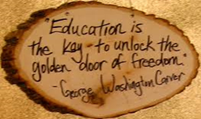
Theoretical Framework
  Piaget’s constructivist theory
  Vygotsky’s sociocultural theory
Conceptual Framework
  NCTM’s Principles and Standards for School Mathematics (2000)
  National Research Council’s Adding It Up ([NRC], 2001)
  CBMS’ The Mathematical Education of Teachers (2001 [MET I], 2010 [MET II])
  Common Core State Standards for Mathematics & Standards for Mathematical Practice ([CCSSM, SMP], NGA/CCSSO, 2010)
  NCTM’s Principles to Actions (2014)

Slide 4
Conference Board of the Mathematical Sciences (CBMS): Recommendations (2001, 2010)
Two critical pillars for mathematics teacher education:
  A well-qualified teacher in every classroom & a challenging curriculum
In mathematics content courses and professional development for elementary teachers, the educational community “should not only aim to remedy weaknesses in mathematical knowledge, but also help teachers develop a deeper and more comprehensive view and understanding of the mathematics they will or already do teach” (p. 23).

Slide 5
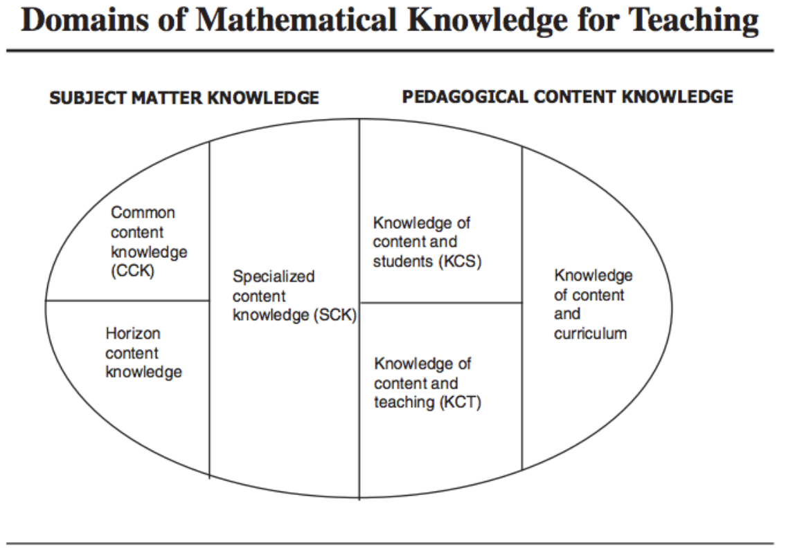
MKT: Specialized content knowledge (SCK)
  Error analysis
  Communicating multiple strategies
  Evaluating methods for accuracy/efficiency
  Being comfortable with various
  mathematical representations
  Carefully selecting problems and cognitively
  demanding mathematical tasks and activities
  Communicating precise meanings of mathematical terms
  Developing the art of using both clarifying and consensus building questions to promote student engagement and learning

Slide 6
Mathematics Self-Efficacy Beliefs
Bandura (1977, 1986) developed what is now called self-efficacy theory - efficacy expectation & outcome expectancy
Four factors which influence efficacy: mastery experiences, vicarious experiences, verbal persuasion, & affective states
Pajares’ (2003) work
Ball’s (1990) TELT study at the National Center for Research on Teacher Education (NCRTE)

Slide 7
SMM
Singapore students consistently place among the best mathematical problem solvers in the world (Beckmann, 2004; Englard, 2010; Hoven & Garelick, 2007).
Model drawing “trains students to think analytically, providing an important transition between the concrete and the abstract” (Forsten, 2010, p. 1).
Like algebraic equations, these diagrams are not meant to help users carry out operations, but to help them decide what operations to use and to understand why those operations are conceptually sound (Beckmann, 2004).

Slide 8
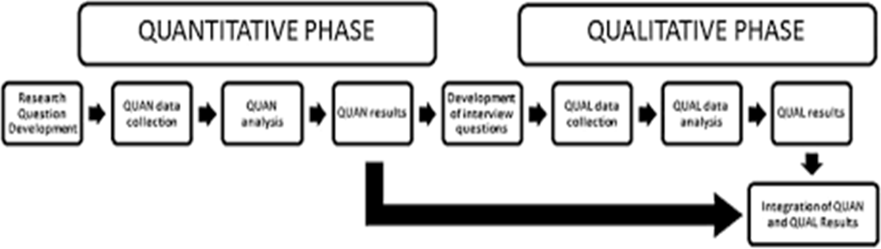
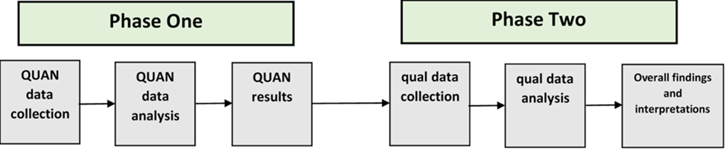
  Methodology: Research Design
  Explanatory sequential mixed methods approach,
  [QUAN → Qual] with quantitative methods and follow up through qualitative methods along with interpretation of data gathered through each method

Slide 9

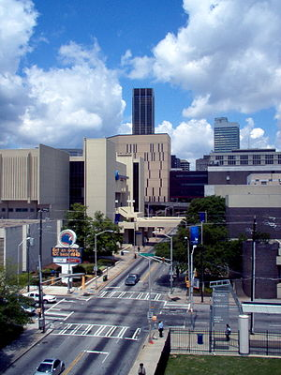
  Context of the Study
  ECEE Program students in one mathematics content class in Fall semester, 2016 (Foundations of Number & Operations)
  Large, public university in the southeastern U.S.
  32 prospective elementary teachers, with 6 of
  them randomly selected for interviews
  Researcher’s role as SMM observer/facilitator of
  SMM intervention/data gatherer/analyst

Slide 10
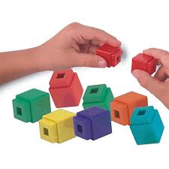
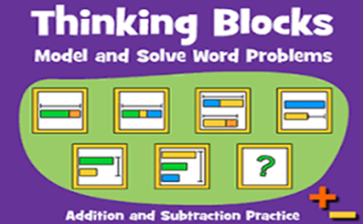
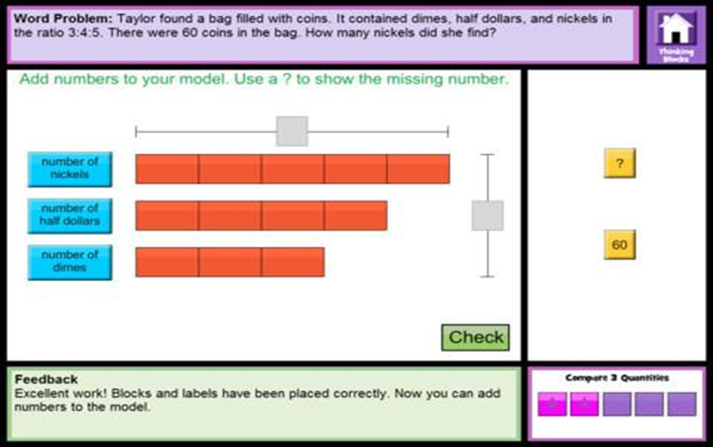
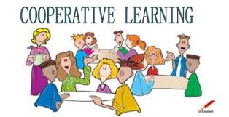
Singapore Modeling Method Intervention
Day 1: Modeling of the SMM based on Forsten’s (2010) and Walker (2010)’s books using PowerPoint/Centimeter Grid Paper Activity with Unifix cubes (60 per group of 3-4 PTs) involving Whole Number Operations, CGI Problem Types
Day 2: Continue SMM practice, Thinking Blocks Website http://www.mathplayground.com/thinkingblocks.html
Day 3: SMM Classwork/Homework
Day 4: Strip Diagrams (Emphasize Ratios, Multiplicative
Comparisons), SMM Centers Activity on Wide Range of Problem Solving Involving Whole Numbers, Fractions, Decimals, and Percents

Slide 11

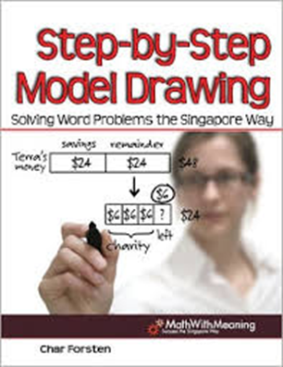

Slide 12
  Quantitative Data Analysis
Analysis of student classwork, homework, and test artifacts using Swars Auslander’s (2016) 5-point rubric
Used collegial collaboration on Mathematics Problem-Solving Assessment coding and used an average of scores
Descriptive statistics (means, standard deviations) using LMT/TKAS website provisions, Excel, & SPSS for analysis and displaying findings
The LMT/TKAS MKT Measures (2 subscales), Mathematics Problem-Solving Assessment, and MSES-R Survey data were analyzed with a paired sample t-test design.
Text, tables, figures, images of various student artifacts

Slide 13
  Qualitative Data Analysis
Used a digital audio recorder to capture the interview data, then used rev.com to transcribe each semi-structured individual interview.
Analyzed these 6 interview transcripts using microanalysis, looking for MKT, mathematics self-efficacy, and other emergent themes. This detailed, line-by-line analysis is necessary to generate initial categories and suggest relationships among categories (Swars, Daane, & Gieson, 2006).
Constant comparative method (Glaser & Strauss, 1967) on interview data
Emergent coding (Lincoln & Guba, 1985) of student interviews; 1-week hiatus and peer debriefing on coding categories, memos, and themes
Peer debriefing with 2 elementary mathematics content colleagues was used to support me in recognizing where my identity was affecting or shaping my analysis of qualitative data (Lincoln & Guba, 1985).
Dedoose online software was used for its data management capabilities.

Slide 14
Ethical Considerations & Data Management
Pseudonyms (PTs selected)
Security of documents
Triangulation
Member checking
Peer debriefing
Researcher audit trail
Pretests/Posttests
Interviews
Student Artifacts

Slide 15
Quantitative Findings Summary
Construct | Paired Sample t-test Results | Conclusion
MKT: Number and Operations | p = 0.541 | Insignificant
MKT: Algebra | p = 0.320 | Insignificant
MKT: Problem Solving | p = 0.154 | Insignificant
Mathematics Self-Efficacy | p = 0.014 | Significant

Slide 16
Discussion: Research Questions 1 & 2
The SMM intervention did not significantly affect change in PTs’ MKT, though two of the three assessments showed positive changes. Perhaps significant shifts were not evidenced in the quantitative data due to the limited duration of the intervention, and other factors may include scaffolding decisions and the nonconsecutive structure of the intervention.
The SMM intervention did significantly affect change in PTs’ mathematics self-efficacy, a finding which was supported in the interview data.
Interview and student artifact data suggested that mastery experiences with the SMM positively influenced PTs’ beliefs about mathematics, MKT, and mathematics self-efficacy.

Slide 17
Research Question 3:
Qualitative Findings -
Five themes and two subthemes

Slide 18
1-Change in beliefs about mathematics
Before the SMM, Allison viewed mathematics as “8,000 formulas” (Allison’s interview, Line 38, November 8, 2016) and needing to recall what to do when. She went on to state, “the hardest for me is to remember I need to do this for this type of problem, but not for that type of problem” (Lines 37-41).
“After the [SMM], I did understand things differently” (Line 50). She found that she could understand and explain things better using this visual way to solve problems. Allison commented about the SMM, “It makes you look at math in a different perspective” (Lines 304-305).

Slide 19
Beliefs Change Discussion
Two other interview participants offered evidence of a shift from viewing mathematics as a set of procedures to seeing mathematics as a conceptual web of interconnected ideas (Ambrose, 2004; Hiebert & Lefevre, 1986).
This is significant because PTs tend toward procedural approaches and have difficulties justifying conceptual understandings (Browning et al., 2014).
Perhaps a part of the solution to the “troubling and unproductive realities” that NCTM (2014) identified is including problem-solving heuristics like the SMM in elementary PT mathematics courses, a notion for which several of the interview participants advocated.

Slide 20
2-MKT: Justifying reasoning in problem solving with visual clarity
Sharonda mentioned that she has learned “better ways to solve problems” (Sharonda’s interview, Line 92, November 9, 2017) in the course. As she noted, “This [the SMM] might be the main thing for me” (Line 96), indicating that the brief 4-day SMM intervention was something of a Math 2008 course highlight for her.
She revealed that she liked this problem-solving approach for a variety of reasons, but especially for “[showing] your thought process for a word problem” (Lines 126-127). Sharonda then elaborated that “it seems plain as day now to show how you got an answer, just to visualize it” (Lines 127-128).

Slide 21
MKT: Justifying reasoning in problem solving with visual clarity
Jimmy declared, "This … is what's going on in my head, when I do it in my head" (Jimmy’s interview, Line 178, November 15, 2016). Probing further, he said as he pointed to a diagram example on his posttest, “the little blocks … (this is) just kind of what’s going on up here. I can spit the number out, but I never really had a way to put it down and show someone what I was thinking” (Lines 182-184).
In addition to seeing the SMM as valid and natural, Jimmy, who described his mathematics ability growing up as “a car’s length ahead of everybody” (Line 17), also recognized his growth in terms of teaching and learning strategies. Jimmy related that the SMM has made him a more critically reflective thinker. Along these lines, he stated that before the intervention, “I just kind of do it instead of thinking about it” (Lines 334-335), but after the intervention, he said he thought more about “how I would do it instead of just doing it” (Line 336).

Slide 22
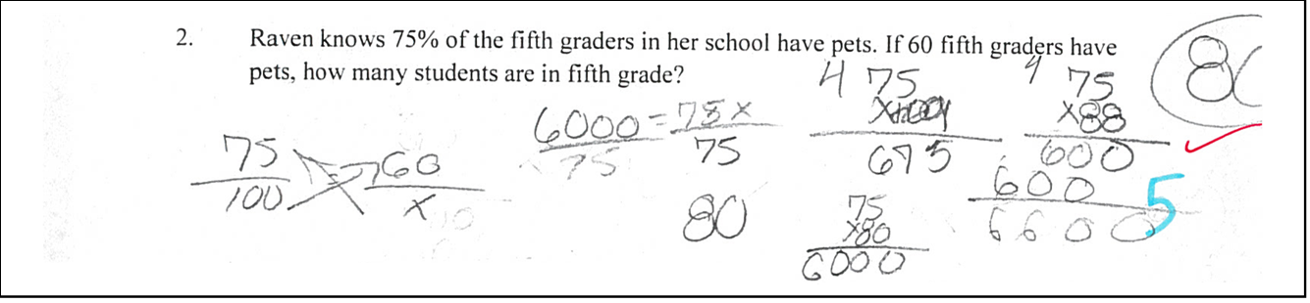
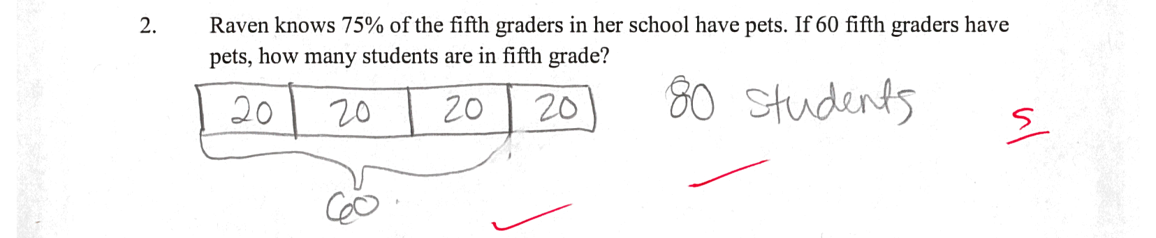
PT Profile Sample: Maria
Figure 10
. Sample Student Work on Mathematics Problem
-
Solving Assessment (Maria’s Pretest,
Problem 2)
Figure 11.
Sample Student Work on Mathematics Problem
-
Solving Assessment (Maria’s
Posttest, Problem 2)

Slide 23
PT Profile Sample: Maria

Slide 24
Justifying Reasoning Discussion
CBMS (2010) stated, “Prospective teachers need to understand the fundamental principles that underlie school mathematics, so that they can teach it to diverse groups of students as a coherent, reasoned activity and communicate an appreciation of the elegance and power of the subject” (p. 17).
Teachers need to have expertise in “monitoring their own progress as they solve problems, attending to precision, constructing viable arguments, seeking and using mathematical structure, and making strategic use of appropriate tools” (p. 1).

Slide 25
3-MKT: Variety of valid strategies
“I think the strategies and the different ways to solve problems now are … easier, better to understand, better for comprehension” (Christy’s interview, Lines 132-133, November 15, 2016).
“When I become a teacher, I can say, ‘Okay if you can't get it this way, you can do it this way, or if not, I have another way.’ It allows me to broaden my way of thinking and to be able to reflect it into the students” (Allison’s interview, Lines 90-93, November 8, 2016)

Slide 26
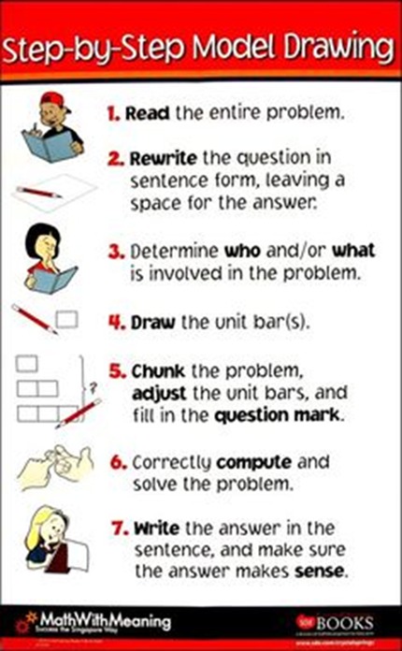
MKT: Variety of valid strategies (SMM’s organizational structure, ease of use)
“The strength, definitely, as I keep saying, [is] the visuals and the steps that you told us to take” (Allison’s interview, Lines 155-156, November 8,2016).
If you use the SMM, “they know exactly what you did and how you got your answer. If you mess up, they can still see exactly what you did wrong because it’s right there”. Later, she commented, “I feel like you can more easily catch yourself when you mess up” (Sharonda’s interview, Lines 153-155, 239-240, November 9, 2016).

Slide 27
MKT: Variety of valid strategies (SMM’s organizational structure, ease of use)
“The strength is that it's very organized. … They see it and instead of having numbers and things everywhere, they have it organized. That's what I liked about it and what I think is the strength of it. Then the weakness, I guess if it was a test and they were pushed for time [and] they have a lot of problems, I don't think they would have time to draw every box for each problem. They wouldn't be able to organize it, which would help them. Because I feel like math, a lot of people that's not good at math, it's because it's everywhere, numbers, and it's making them crazy. I feel like this is so organized, it would make everything settle down and they won't be so flustered” (Jack’s interview, Lines 206-215, November 14, 2016).

Slide 28
Valid Strategies Discussion
Related to the SMM and CGI problem type frameworks, mathematics education research has consistently shown that students who can classify problems on the basis of their semantic structures are better problem solvers than students who do not have knowledge of problem types (Morales, Shute, & Pellegrino, 1985; Schoenfeld & Herrmann, 1982).
Commenting on the SMM, Murata (2008) concluded that “mediating tools, such as tape diagrams, support people’s cognitive development by helping organize their experiences in a systematic way” (p. 401).
This sort of organized approach is a clear strength of the SMM framework, as evidenced by other studies with K-5 students (Cai & Brook, 2003; Englard, 2010; Ho & Lowrie, 2014; Koedinger & Terao, 2002; Ng & Lee, 2005, 2009; Willis & Fuson, 1988) and by PTs’ interview data in this study.

Slide 29
4-Changes in mathematics self-efficacy and connections with MKT
"It's not my ability that's changed, it's the fact that I can show my work and explain how I do it instead of just doing it” (Jimmy’s interview, Lines 96-97, November 15, 2016).
“I think that would help with my confidence, if someone asks why, you're not just like, 'Oh, because that's just how it is', you can actually sit down and explain it" (Lines 97-99). In the interview, when probed about whether his confidence changes were because of new strategies or the ability to explain it better, Jimmy quickly responded: ‘strategies’’’ (Line 101).

Slide 30
Changes in mathematics self-efficacy and connections with MKT

Slide 31
Changes in mathematics self-efficacy and connections with MKT
After further attributing her MKT and confidence growth to “having two passionate teachers that actually enjoy math” (Line 76), Allison offered a nice summary statement linking mathematics self-efficacy to knowing a variety of problem-solving strategies. Supporting this connection, she said, “Just because I know it one way and I'm confident, now I'm confident in doing it in a whole different way, and it makes a difference” (Allison’s interview, Lines 88-90, November 8, 2016).
“I can explain to the students better and I feel more confident in teaching it because I know different ways and because I learned more things about it” (Lines 172-173).

Slide 32
Mathematics Self-Efficacy Discussion
Consistently in the interview excerpts, PTs spoke about growth in their ability to do mathematics with conceptual understanding, both in terms of showing their work and explaining their reasoning to others, and with these remarks, they made clear connections to growth in self-efficacy.
Several interview participants also expressed growth in metacognition or reflection about their own thinking in mathematics problem-solving contexts.
In MET II (2010), the CBMS concluded that “instructors may need to spend time focusing on the importance of not only a productive disposition toward mathematics, but a recognition of the depth and importance of elementary mathematics” (p. 34) in the CCSSM.

Slide 33
5-Implications for future teaching
“Math anxiety starts in elementary school, like around first and second grade. If you introduce something like this to elementary … students, then maybe they won't have that anxiety on through the rest of their life.... This might change the future for them. I just believe, because after doing that study on math anxiety [in another course], I felt like it's because teachers don't spend extra time or find different strategies or concepts. Whatever way that the book has put, that's what they're teaching nowadays. Introducing something like SMM would be very helpful then. It will help a lot of students down the path. They'll use it later on in life when they take high school math classes when they're struggling. I just feel like, I will use it because of that reason to prevent math anxiety and prevent students hating math, because once you get good at it, it's pretty fun.” (Jack’s interview, Lines 379-390, November 14, 2016)

Slide 34
Implications for future teaching
“I definitely think it's beneficial because as we talked about before, every child learns differently, and you have a lot of kids now that don't particularly like math, so you have to give it to them in a way for them to understand it and to know several different ways. And I feel like [the] Singapore Method is a great method and is a great way to teach a child who is very visual … or a kinesthetic learner where they can be hands on about it, rather than algebraic.... Will I make this my top choice? … Elementary, yes.... this is
a great foundation in math. I think with a foundation like this, you build student's confidence in math for them to actually enjoy the subject more because if you have confidence, you enjoy it. You're typically going to do much better than if you hate it and you're struggling and you don't even want to do it. I definitely think it gives more confidence to students. It makes you look at math in a different perspective” (Allison’s interview, Lines 291-305, November 8, 2016).

Slide 35
Discussion: Implications for future teaching
"I feel like it's a good teaching strategy, you know, especially for struggling students. I feel like they should use it in teacher education programs" (Jack’s interview, Lines 395-396, November 14, 2016).
Several interview participants mentioned the importance of SMM for visual, kinesthetic, and struggling mathematics learners, and others advocated for the use of SMM in teacher education programs.
Interview participants volunteered their commitment to using the SMM in their future as teachers. Their rationale involved MKT and mathematics self-efficacy.

Slide 36
Recommendations for future research
Similar studies with larger samples of elementary PTs in a college or university setting (with the suggested improvements)
A study exploring whether learning styles influence the impact of the SMM on PTs’ MKT and mathematics self-efficacy
A study comparing the use of the SMM with elementary PTs in a Foundations of Number and Operations course vs. an Algebraic Concepts course (with a covariate)
An experimental study with a treatment group getting exposure to SMM and a control group getting a traditional problem-solving approach, with a covariate (like GPA, SATM, or previous mathematics course grade)
A study involving PT-student interactions during a SMM intervention, with qualitative interview analysis (e.g., Philipp et al., 2007)
A pretest/posttest t-test design with elementary teachers through a SMM professional development workshop, exploring MKT and teacher efficacy

Slide 37
  Limitations
  Small sample size (N = 32), short time span (16-week course with a 4-week intervention on consecutive Tuesdays in October)
  The Mathematics Problem-Solving Assessment and other student artifacts were not tested for reliability and validity.
  Poor inter-rater reliability (65.6 & 70%) on the Mathematics Problem-Solving Assessment pretest and posttest scoring
  The researcher is the only data gatherer and coder of all qualitative data.
  Ball (2000) warned that the “close study of a single teacher, in a particular setting, with specific content and students, no matter how carefully done or how captivating, always raises questions about the domain of the results” (p. 393).

Slide 38
Closing Thoughts
CBMS (2010) supported the notion that all mathematics courses for PTs “develop the habits of mind of a mathematical thinker and problem-solver, such as reasoning and explaining, modeling, seeing structure, and generalizing” (p. 19), all core principles in the SMM intervention.
This was a first study on at least two fronts …
I trust that the PTs’ voices were well-represented, understandable, and impactful and that this SMM study contributes to conversations about elementary mathematics PT preparation efforts.
Thank you for your thoughtful attention!

